Slide 1

Project : Data Analysis
Claudio Do Prado
Monitoring wage costs

Slide 2
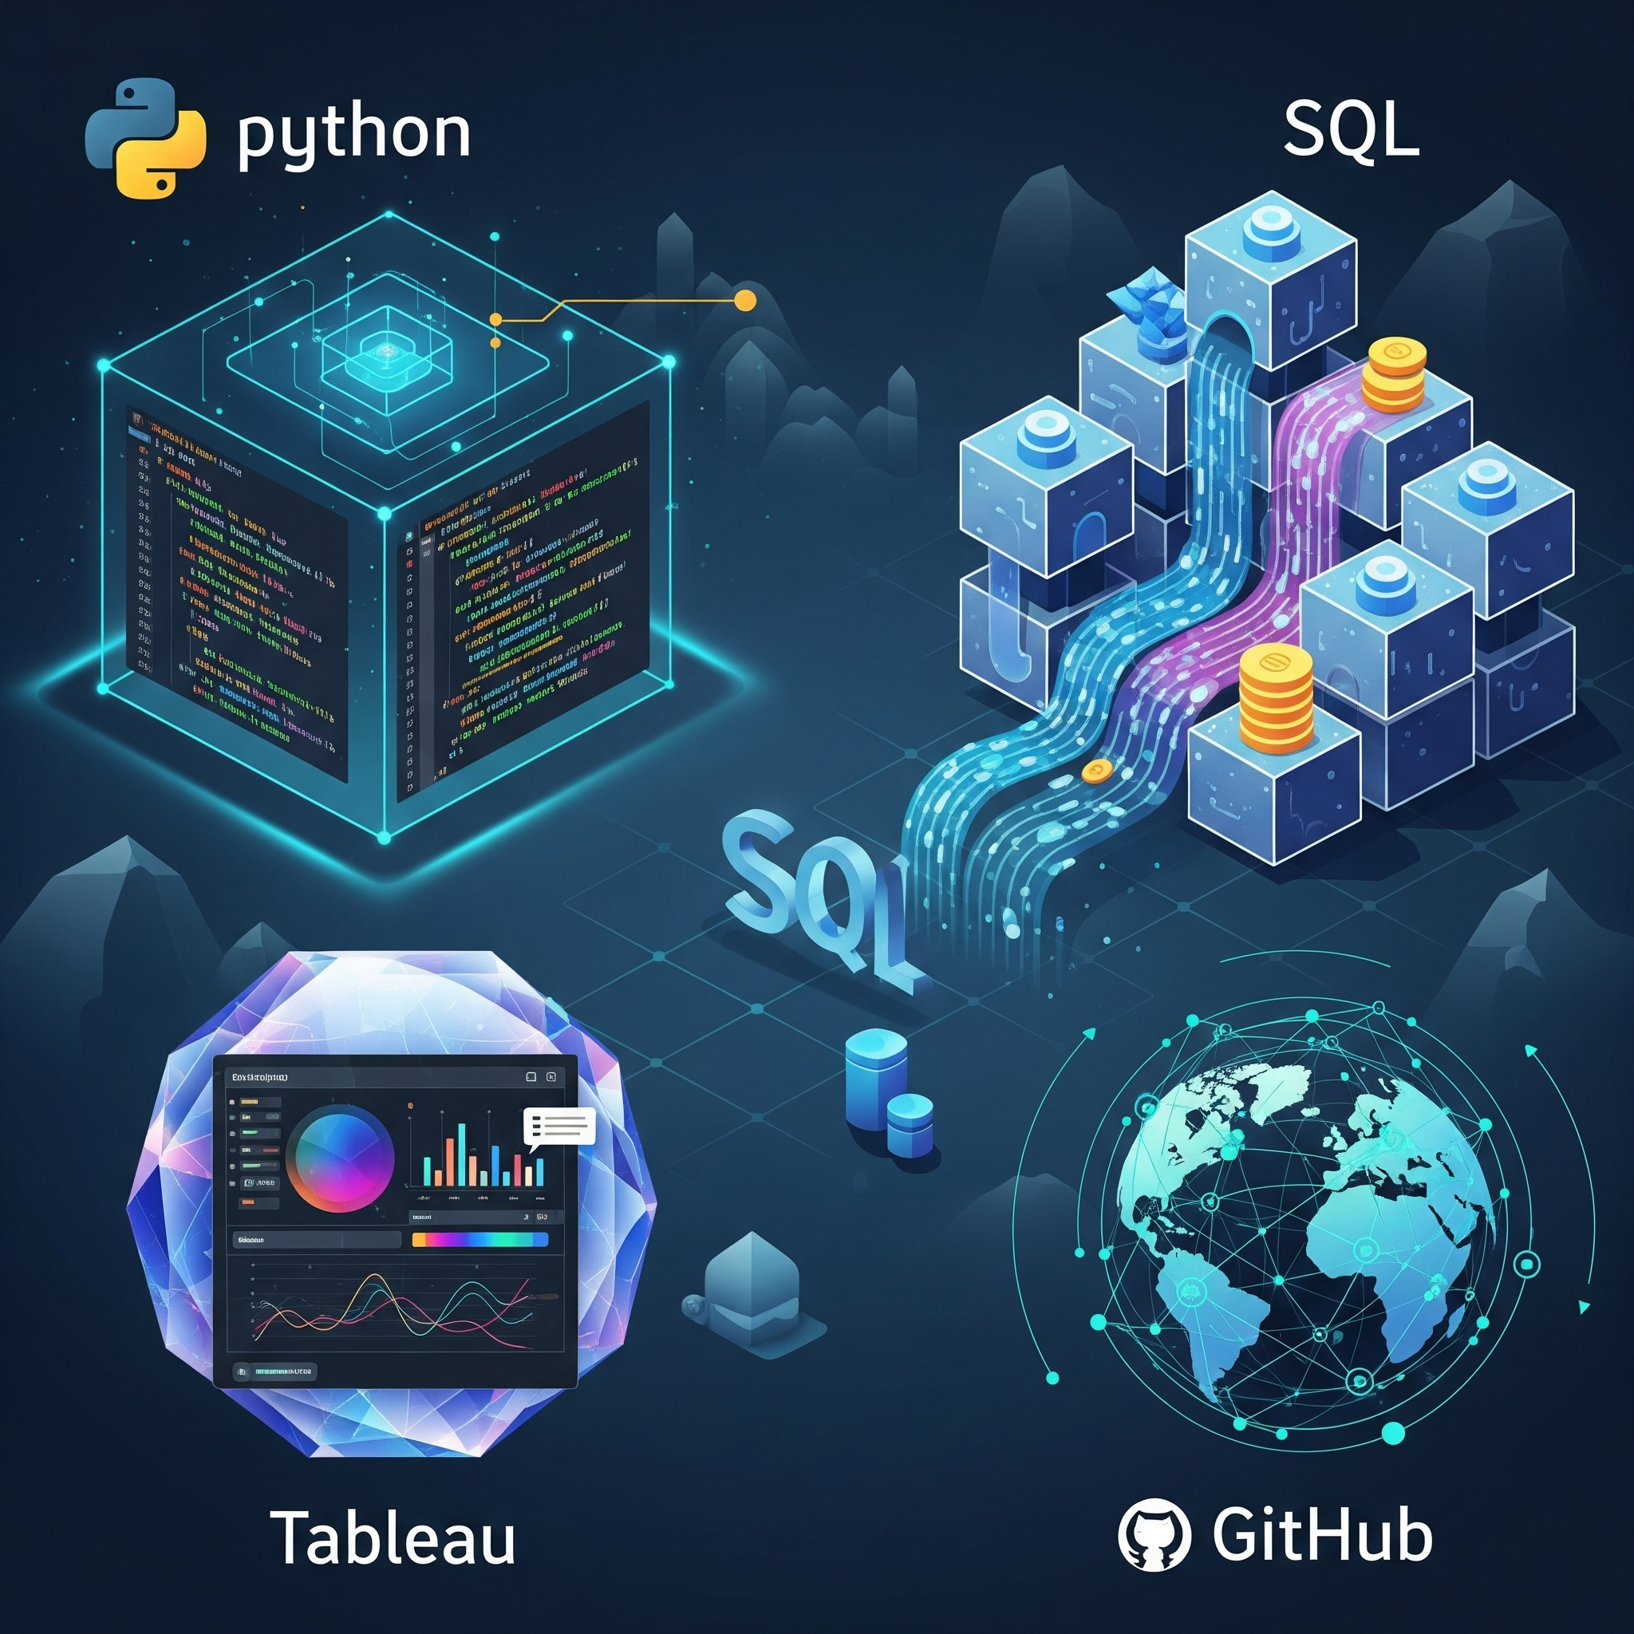
Tools Used
Python for data manipulation and analysis.
SQL for database querying techniques.
Tableau for data visualization.
GitHub to save latest updates.

Slide 3

How to improve profit margins?
Analyze wage costs for profit improvement.
Identify cost reduction opportunities using data.
Improve profit through wage cost analysis.

Slide 4
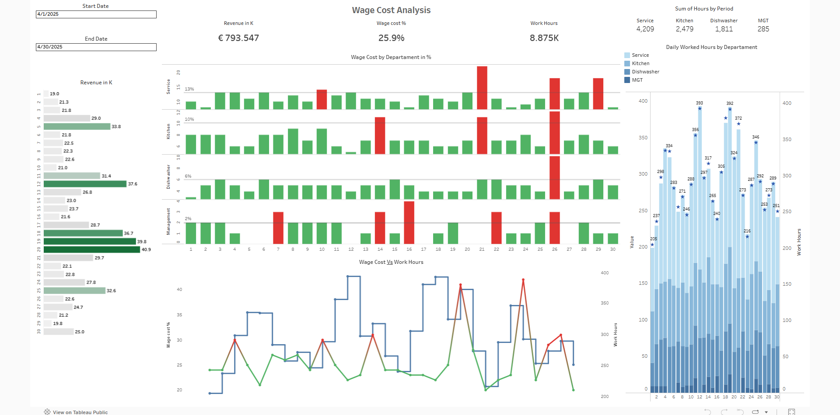

Slide 5

Conclusion and Next Steps
Optimize staff scheduling.
Explore ways to improve efficiency in each departments.
Continue tracking daily labor costs.
Create a ML for forecasting daily revenue and schedule accordingly.

Slide 6



Special Thanks You!
Queen Erin
Felipe
Simi

